Slide 1
CMP5329 Cyber Security
Week 1-P1: Modern Symmetric Ciphers
PhD. Ngoc-Tu Nguyen
tunn@uit.edu.vn

Slide 2
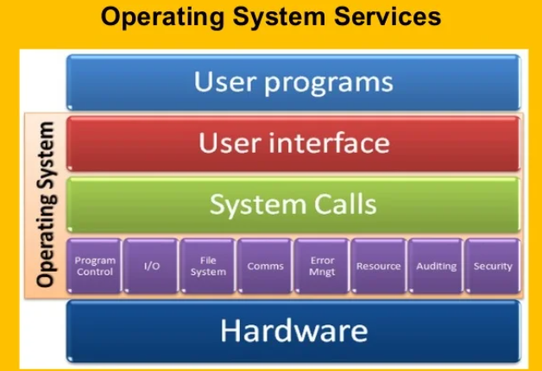








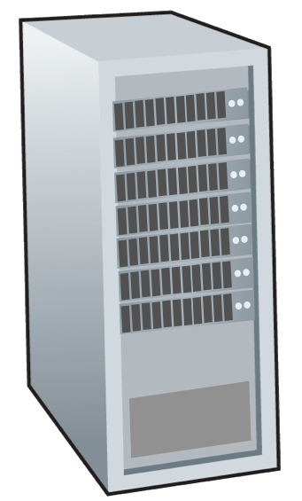







Motivations
Data Protection
mobile network
national or global ISP
Data
Transmission state
Process state
Storage state
local or regional ISP
Internet
home network
content
provider
network
datacenter
network
enterprise
network
Network or host?

Slide 3
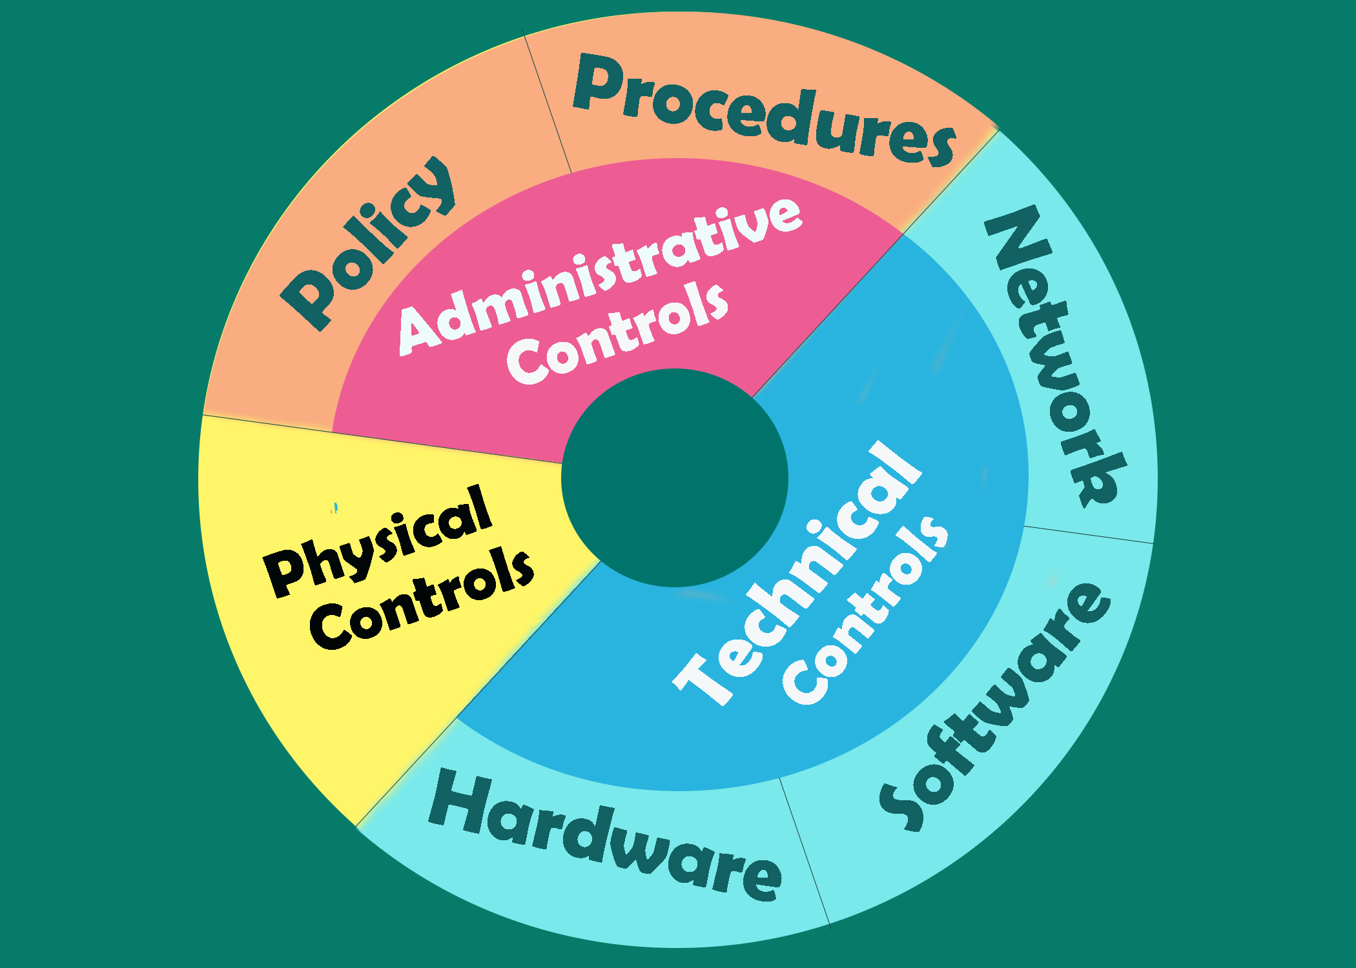
Motivations
Defense in depth:
assets
Notes:
Defence in depth:

Slide 4
What is cryptograph?
Cryptology= Cryptography + Cryptanalysis
Goals
What?
Cipher systems
- Sysmmetric (AES)
- Asymmetric (RSA, ECC, CRYSTALS-KYBER)
Confidentiality
Privacy
Integrity
Hash functions
Message authentication code (MAC)
Digital signature (digital certificate)
Authentication
Non-repudiation (Accountability)
Availability

Slide 5
Cryptanalysis on monoalphabetic cipher?
hzsrnqc klyy wqc flo mflwf ol zqdn nsoznj wskn lj xzsrbjnf, wzsxz gqv zqhhnf ol ozn glco zlfnco hnlhrn; nsoznj jnrqosdnc lj fnqj kjsnfbc, wzsxz sc xnjoqsfrv gljn efeceqr. zn rsdnb qrlfn sf zsc zlecn sf cqdsrrn jlw, wzsoznj flfn hnfnojqonb. q csfyrn blgncosx cekksxnb ol cnjdn zsg. zn pjnqmkqconb qfb bsfnb qo ozn xrep, qo zlejc gqozngqosxqrrv ksanb, sf ozn cqgn jllg, qo ozn cqgn oqprn, fndnj oqmsfy zsc gnqrc wsoz loznj gngpnjc, gexz rncc pjsfysfy q yenco wsoz zsg; qfb wnfo zlgn qo naqxorv gsbfsyzo, lfrv ol jnosjn qo lfxn ol pnb. zn fndnj ecnb ozn xlcv xzqgpnjc wzsxz ozn jnkljg hjldsbnc klj soc kqdlejnb gngpnjc. zn hqccnb onf zlejc leo lk ozn ownfov-klej sf cqdsrrn jlw, nsoznj sf crnnhsfy lj gqmsfy zsc olsrno.

Slide 6
Outline
Classical cipher algorithms (review)
Stream Cipher
Block cipher
Data Encryption Standard (DES)
Advanced Encryption Standard (AES)
Some other ciphers
Searchable encryption
Notes:
Cipher=a secret system of writing;

Slide 7
Cryptanalysis on monoalphabetic cipher
hzsrnqc klyy wqc flo mflwf ol zqdn nsoznj wskn lj xzsrbjnf, wzsxz gqv zqhhnf ol ozn glco zlfnco hnlhrn; nsoznj jnrqosdnc lj fnqj kjsnfbc, wzsxz sc xnjoqsfrv gljn efeceqr. zn rsdnb qrlfn sf zsc zlecn sf cqdsrrn jlw, wzsoznj flfn hnfnojqonb. q csfyrn blgncosx cekksxnb ol cnjdn zsg. zn pjnqmkqconb qfb bsfnb qo ozn xrep, qo zlejc gqozngqosxqrrv ksanb, sf ozn cqgn jllg, qo ozn cqgn oqprn, fndnj oqmsfy zsc gnqrc wsoz loznj gngpnjc, gexz rncc pjsfysfy q yenco wsoz zsg; qfb wnfo zlgn qo naqxorv gsbfsyzo, lfrv ol jnosjn qo lfxn ol pnb. zn fndnj ecnb ozn xlcv xzqgpnjc wzsxz ozn jnkljg hjldsbnc klj soc kqdlejnb gngpnjc. zn hqccnb onf zlejc leo lk ozn ownfov-klej sf cqdsrrn jlw, nsoznj sf crnnhsfy lj gqmsfy zsc olsrno.

Slide 8
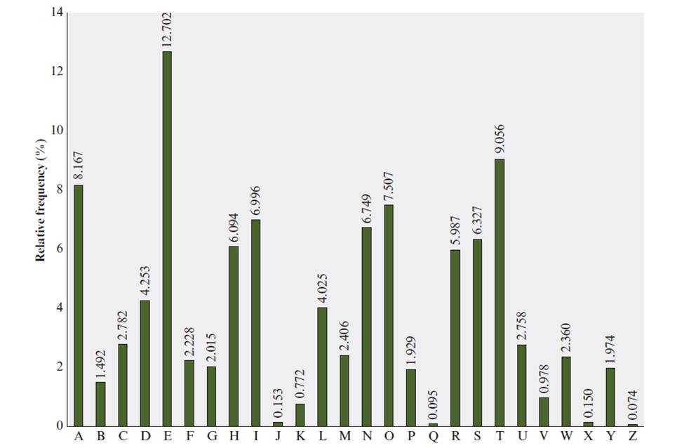
Relative Frequency of Letters in English Text
Notes:
There is, however, another line of attack. If the cryptanalyst knows the nature
of the plaintext (e.g., noncompressed English text), then the analyst can exploit the
regularities of the language. To see how such a cryptanalysis might proceed, we give
a partial example here that is adapted from one in [SINK09]. The ciphertext to be
solved is
UZQSOVUOHXMOPVGPOZPEVSGZWSZOPFPESXUDBMETSXAIZ
VUEPHZHMDZSHZOWSFPAPPDTSVPQUZWYMXUZUHSX
EPYEPOPDZSZUFPOMBZWPFUPZHMDJUDTMOHMQ
As a first step, the relative frequency of the letters can be determined and
compared to a standard frequency distribution for English, such as is shown in
Figure 3.5 (based on [LEWA00]). If the message were long enough, this technique
alone might be sufficient, but because this is a relatively short message, we cannot
expect an exact match. In any case, the relative frequencies of the letters in the
ciphertext (in percentages) are as follows:
P 13.33 H 5.83 F 3.33 B 1.67 C 0.00
Z 11.67 D 5.00 W 3.33 G 1.67 K 0.00
S 8.33 E 5.00 Q 2.50 Y 1.67 L 0.00
U 8.33 V 4.17 T 2.50 I 0.83 N 0.00
O 7.50 X 4.17 A 1.67 J 0.83 R 0.00
M 6.67
Comparing this breakdown with Figure 3.5, it seems likely that cipher letters P
and Z are the equivalents of plain letters e and t, but it is not certain which is which.
The letters S, U, O, M, and H are all of relatively high frequency and probably correspond
to plain letters from the set {a, h, i, n, o, r, s}. The letters with the lowest
frequencies (namely, A, B, G, Y, I, J) are likely included in the set {b, j, k, q, v, x, z}.
There are a number of ways to proceed at this point. We could make some tentative
assignments and start to fill in the plaintext to see if it looks like a reasonable
“skeleton” of a message. A more systematic approach is to look for other regularities.
For example, certain words may be known to be in the text. Or we could look for
repeating sequences of cipher letters and try to deduce their plaintext equivalents.

Slide 9
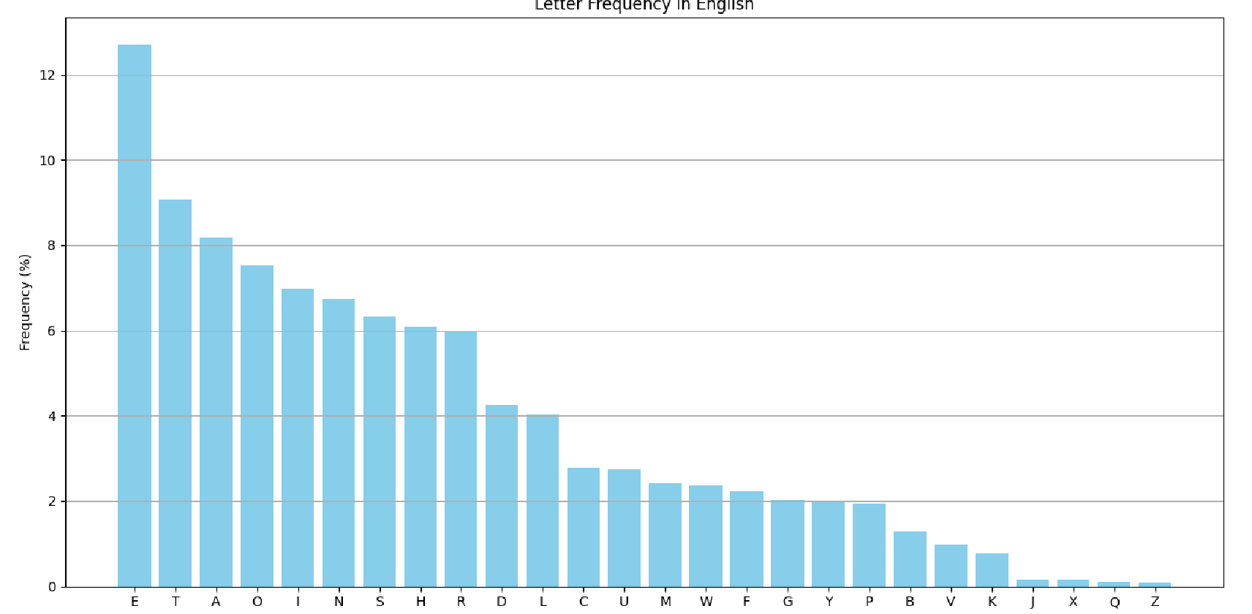
Relative Frequency of Letters in English Text

Slide 10
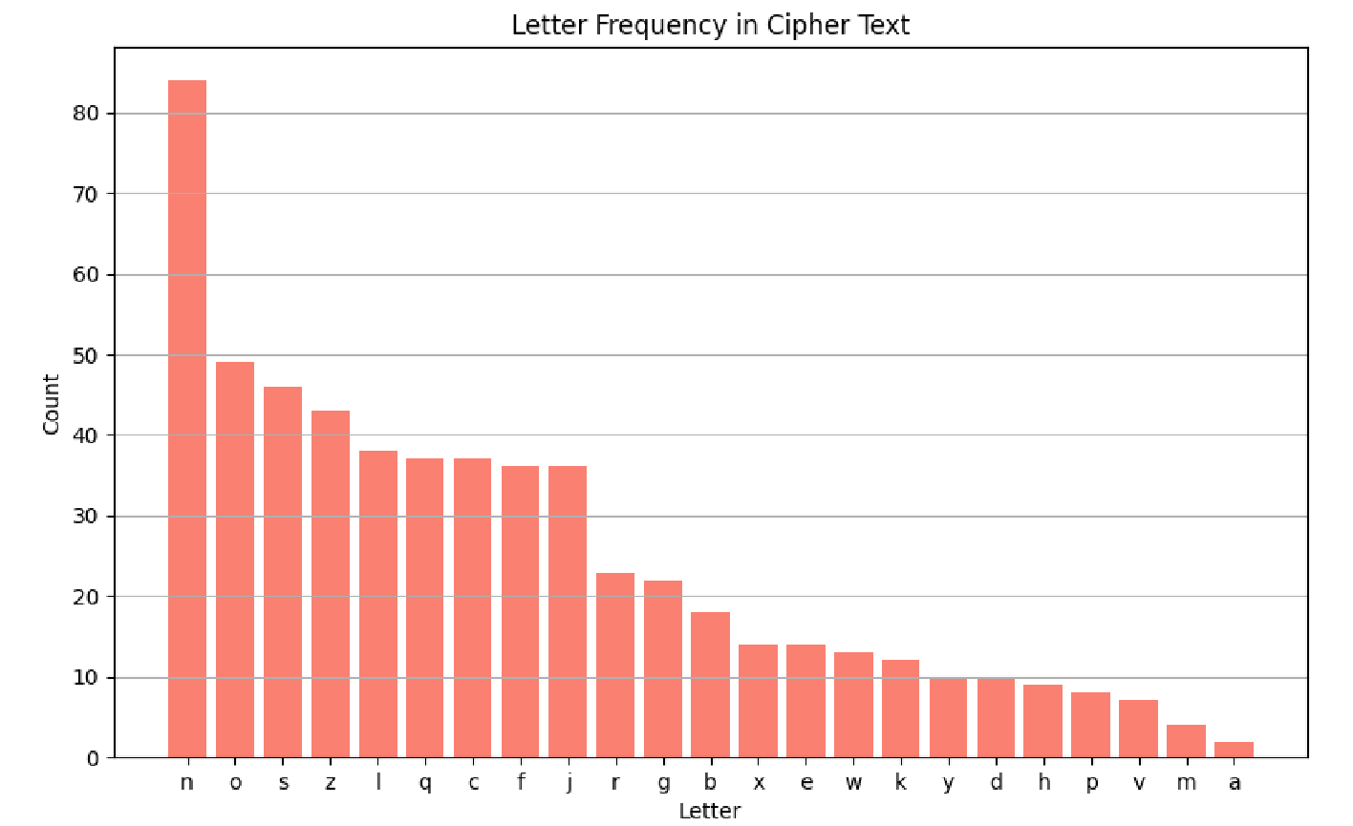
Cryptanalysis on monoalphabetic cipher

Slide 11
Cryptanalysis on monoalphabetic cipher

Slide 12
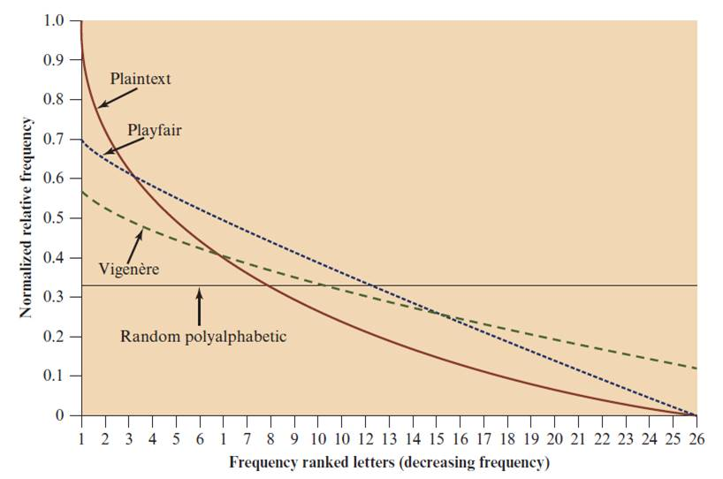
Classical symmetric cipher cryptanalysis

Slide 13
Outline
Stream Cipher
Block cipher
Data Encryption Standard (DES)
Advanced Encryption Standard (AES)
Some other ciphers
Searchable encryption
Notes:
Cipher=a secret system of writing;

Slide 14
Block Cipher
A block of plaintext is treated as a whole and used to produce a ciphertext block of equal length
Typically a block size of 64 or 128 bits is used
As with a stream cipher, the two users share a symmetric encryption key
The majority of network-based symmetric cryptographic applications make use of block ciphers
Notes:
A block cipher is one in which a block of plaintext is treated as a whole
and used to produce a ciphertext block of equal length. Typically, a block size of
64 or 128 bits is used. As with a stream cipher, the two users share a symmetric
encryption key (Figure 4.1b). Using some of the modes of operation explained
in Chapter 7, a block cipher can be used to achieve the same effect as a stream
cipher.
Far more effort has gone into analyzing block ciphers. In general, they seem
applicable to a broader range of applications than stream ciphers. The vast majority
of network-based symmetric cryptographic applications make use of block
ciphers. Accordingly, the concern in this chapter, and in our discussions throughout
the book of symmetric encryption, will primarily focus on block ciphers.

Slide 15

Encryption and Decryption Tables for Substitution Cipher
$$b_{1}b_{2}b_{3}b_{4}$$
Plaintext | Ciphertext
0000 | 1110
0001 | 0100
0010 | 1101
0011 | 0001
0100 | 0010
0101 | 1111
0110 | 1011
0111 | 1000
1000 | 0011
1001 | 1010
1010 | 0110
1011 | 1100
1100 | 0101
1101 | 1001
1110 | 0000
1111 | 0111
Ciphertext | Plaintext
0000 | 1110
0001 | 0011
0010 | 0100
0011 | 1000
0100 | 0001
0101 | 1100
0110 | 1010
0111 | 1111
1000 | 0111
1001 | 1101
1010 | 1001
1011 | 0110
1100 | 1011
1101 | 0010
1110 | 0000
1111 | 0101
Notes:
The encryption and decryption mappings can be defined
by a tabulation, as shown in Table 4.1. This is the most general form of block cipher
and can be used to define any reversible mapping between plaintext and ciphertext.
Feistel refers to this as the ideal block cipher, because it allows for the maximum
number of possible encryption mappings from the plaintext block [FEIS75].

Slide 16
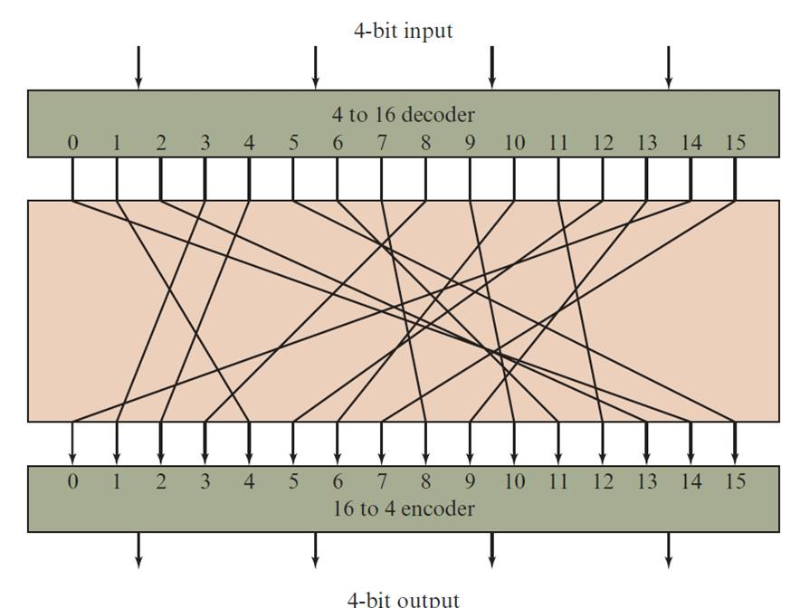



Block Substitution
$$b_{1}b_{2}b_{3}b_{4}$$
4-bits block substitution
0000
$${Keys: 2}^{4}!$$
$$c_{1}c_{2}c_{3}c_{4}$$
1111
Notes:
A block cipher operates on a plaintext block of n bits to produce a ciphertext
block of n bits. There are 2^{n} possible different plaintext blocks and, for the
encryption to be reversible (i.e., for decryption to be possible), each must produce
a unique ciphertext block. Such a transformation is called reversible, or nonsingular.
Figure 4.2 illustrates the logic of a general substitution cipher for n = 4.
A 4-bit input produces one of 16 possible input states, which is mapped by the substitution
cipher into a unique one of 16 possible output states, each of which is represented
by 4 ciphertext bits.

Slide 17



Block Substitution
How many possible substitutions for a block n-bit?
$$b_{1}b_{2}b_{3}….b_{n}$$
$$c_{1}c_{2}c_{3}….c_{n}$$
$${Keys: 2}^{n}!$$

Slide 18
Is DES good enough?
Security strength of DES
Number of rounds
Length of encryption key
Construction of the substitute function
DES was used up to the 1990’s.
People began to take on the DES Challenges to crack DES
Only uses 56-bit keys = 2⁵⁶ ~ 7.2× 10¹⁶ keys

Slide 19
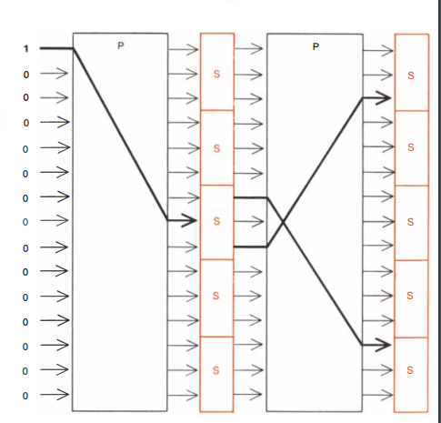
DES Encryption and Decryption (16 rounds)

Slide 20
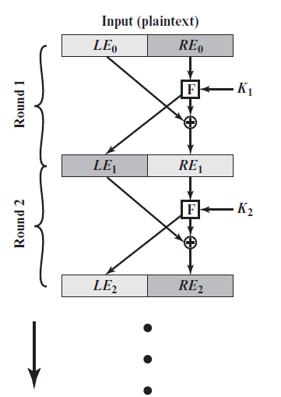
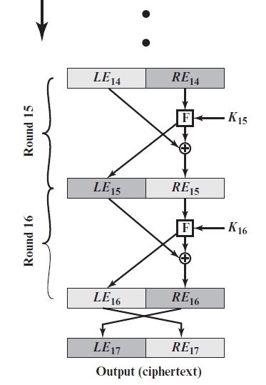
DES Encryption and Decryption (16 rounds)
P.126

Slide 21
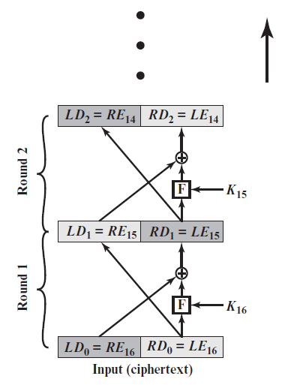
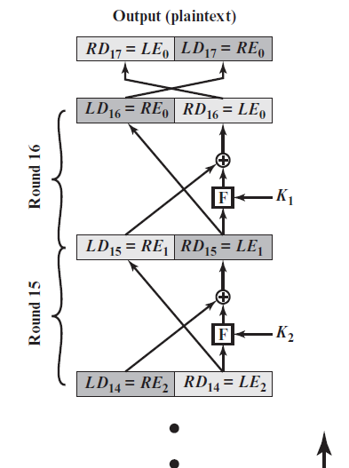
DES Encryption and Decryption (16 rounds)

Slide 22
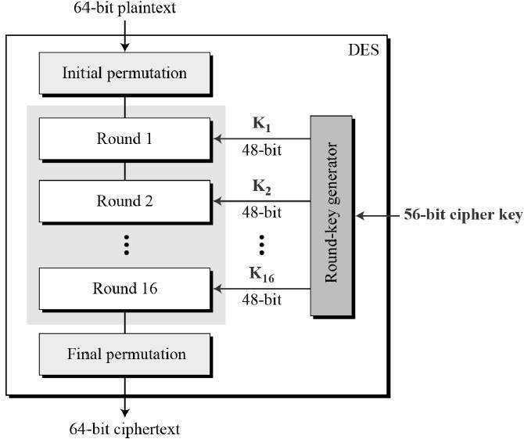
DES Encryption Algorithm
Notes:
The overall scheme for DES encryption is illustrated in Figure 4.5. As with any encryption
scheme, there are two inputs to the encryption function: the plaintext to be
encrypted and the key. In this case, the plaintext must be 64 bits in length and the
key is 56 bits in length.
Looking at the left-hand side of the figure, we can see that the processing
of the plaintext proceeds in three phases. First, the 64-bit plaintext passes through
an initial permutation (IP) that rearranges the bits to produce the permuted input .
This is followed by a phase consisting of sixteen rounds of the same function, which
involves both permutation and substitution functions. The output of the last (sixteenth)
round consists of 64 bits that are a function of the input plaintext and the
key. The left and right halves of the output are swapped to produce the preoutput .
Finally, the preoutput is passed through a permutation [IP ⁻¹ ] that is the inverse of
the initial permutation function, to produce the 64-bit ciphertext. With the exception
of the initial and final permutations, DES has the exact structure of a Feistel
cipher, as shown in Figure 4.3.
The right-hand portion of Figure 4.5 shows the way in which the 56-bit key is
used. Initially, the key is passed through a permutation function. Then, for each of
the sixteen rounds, a subkey (K_{i} ) is produced by the combination of a left circular
shift and a permutation. The permutation function is the same for each round, but a
different subkey is produced because of the repeated shifts of the key bits.
As with any Feistel cipher, decryption uses the same algorithm as encryption,
except that the application of the subkeys is reversed. Additionally, the initial and
final permutations are reversed.

Slide 23
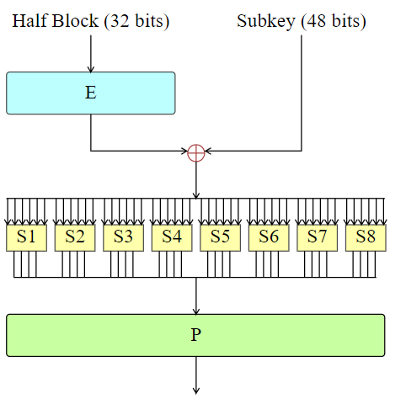
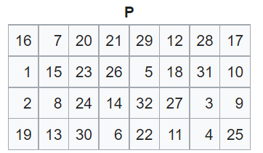
DES review
F(R_{i–1}, K_{i}) = P(S(EP(R_{i–1}) ⊕ K_{i})), i = 1,…,16
Substitution
Permutation

Slide 24
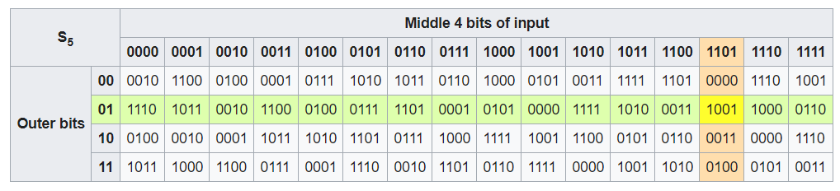
DES Substitution Boxes
Input: “011011”
Output: “1001”

Slide 25
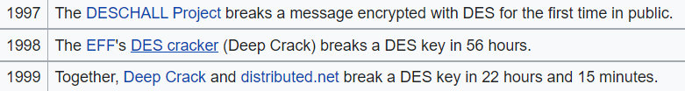
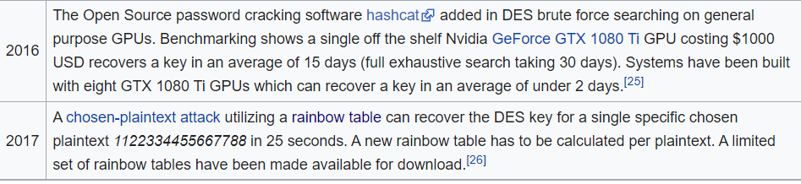
DES review
Security analysis
Key spaces: ${\left\{0,1\right\}}^{56}=2^{56}$possible keys
Brute Force attacks
https://en.wikipedia.org/wiki/Data_Encryption_Standard

Slide 26
What to Do Next?
Start over
New standards begin to be looked into
On the other hand, can we extend the use of DES?
Notes:
Start over =Start again

Slide 27
Outline
Stream Cipher
Block cipher
Data Encryption Standard (DES)
Advanced Encryption Standard (AES)
Some other ciphers
Searchable encryption
Notes:
Cipher=a secret system of writing;

Slide 28
Advanced Encryption Standard
Advanced Encryption Standard competition began in 1997
Rijndael was selected to be the new AES in 2001
AES basic structures:
block cipher, but not Feistel cipher
encryption and decryption are similar, but not symmetrical
basic unit: byte, not bit
block size: 16-bytes (128 bits)
three different key lengths: 128, 192, 256 bits (AES-128, AES-192, AES-256)
each 16-byte block is represented as a 4 x 4 square matrix, called the state matrix
the number of rounds depends on key lengths
4 simple operations on the state matrix every round (except the last round)

Slide 29
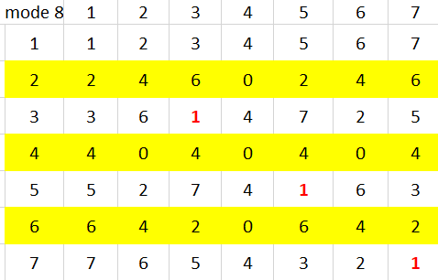
Finite Field Arithmetic
p is a prime number
is a finite field;
N=2^{n} is a composite number
is a finite field?
NO!
Example:
3.3 mode 8 =1
2.x mode 8 =1?
But is a finite field!
5.5 mode 8 =1
4.x mode 8 =1?
7.7 mode 8 =1
6.x mode 8 =1?

Slide 30
Finite Field Arithmetic
If one of the operations used in the algorithm is division, then we need to work in arithmetic defined over a field
Division requires: nonzero element have a multiplicative inverse
For convenience and for implementation efficiency we would like to work with integers that fit exactly into a given number of bits with no wasted bit patterns
Integers in the range 0 through 2^{n} – 1, which fit into an n-bit word
The set of such integers, Z₂^{n}, using modular arithmetic, is not a field
The integer 2 has no multiplicative inverse in Z₂^{n}, (no integer b, such that:
2.b mod 2^{n} = 1)
A finite field containing 2^{n} elements is referred to as G F(2^{n})
Every polynomial in G F(2^{n}) can be represented by an n-bit number

Slide 31
The Four Simple Operations
substitute-bytes (sub)
Non-linear operation based on a defined substitution box
Used to resist cryptanalysis and other mathematical attacks
shift-rows (shr)
Linear operation for producing diffusion
mix-columns (mic)
Elementary operation also for producing diffusion
add-round-key (ark)
Simple set of ⊕ operations on state matrices
Linear operation
Produces confusion

Slide 32
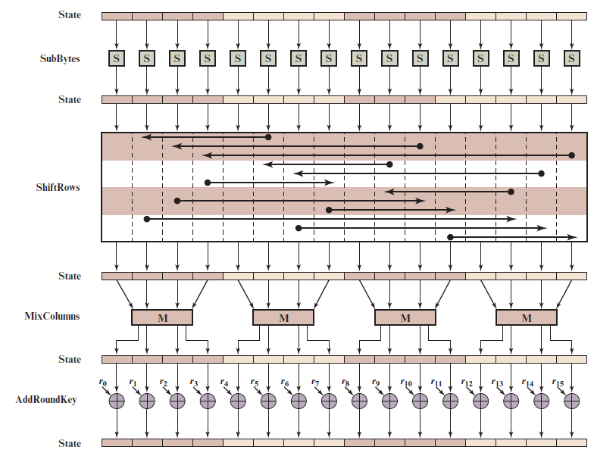
A E S Encryption Round
16 bytes
Notes:
Figure 6.4 depicts the structure of a full encryption round.

Slide 33
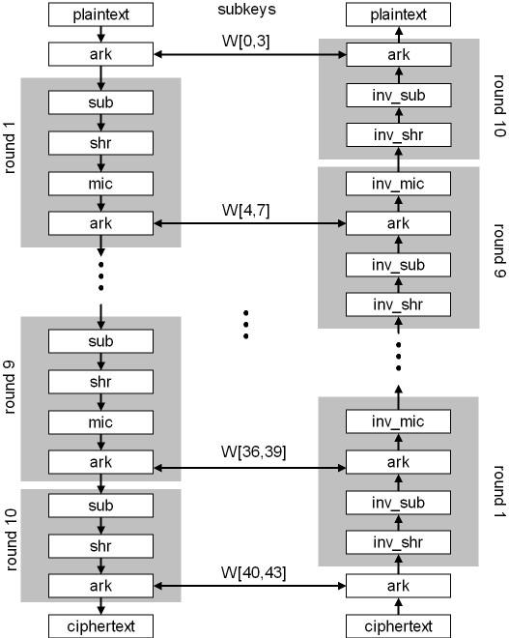
AES-128
AES-128: 10 rounds
AES-192: 12 rounds
AES-256:14 round

Slide 34
AES Substution Box (S-Box)
S-box: a $16×16$ matrix built from operations over finite field GF(2⁸)
permute all 256 elements in GF(2⁸)
each element and its index are represented by two hexadecimal digits
Let w = b₀ ... b₇ be a byte. Define a byte-substitution function S as follows:
Let i = b₀b₁b₂b₃, the binary representation of the row index
Let j = b₄b₅b₆b₇, the binary representation of the column index
Let S(w) = s_{ij,} S⁻¹(w) = s’_{ij}
We have S(S⁻¹(w)) = w and S⁻¹(S(w)) = w

Slide 35
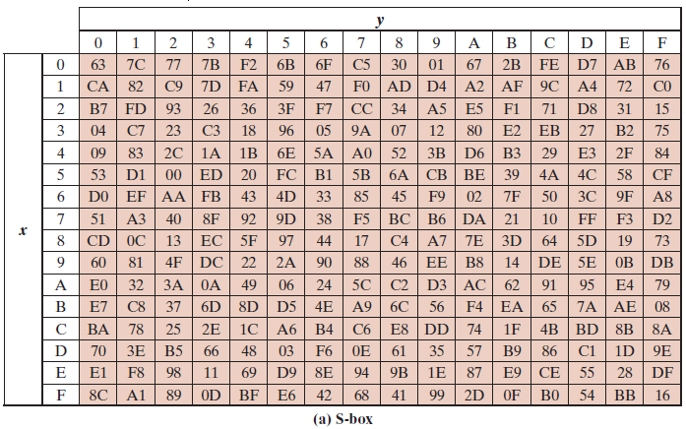
AES S-Boxes (1 of 2)
P=1101 0011
13
i =D
j= 3
C=66 = (01100110)₂

Slide 36
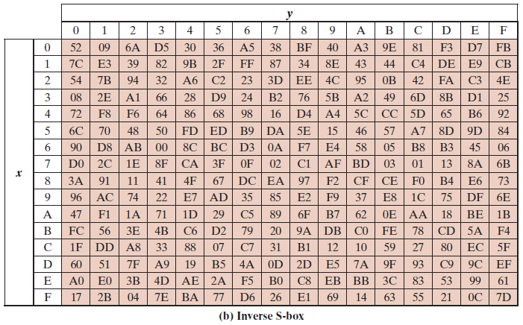
AES inverse substution Box (2 of 2)
C=66 = (0110 0110)₂
i =6
j=6
P=D3 = (1101 0011)₂
Notes:
The inverse substitute byte transformation , called InvSubBytes, makes use
of the inverse S-box shown in Table 6.2b.

Slide 37
Substitute-Bytes (sub)
Substitution function that takes a byte as an input, uses its first four bits as the row index and the last four bits as the column index, and outputs a byte using a table-lookup at the S-box
Let A be a state matrix. Then
S(a_{0,0} ) S(a_{0,1} ) S(a_{0,2} ) S(a_{0,3} )
C=sub(A) = S (a_{1,0} ) S(a_{1,1} ) S(a_{1,2} ) S(a_{1,3} ) S(a_{2,0} ) S(a_{2,1} ) S(a_{2,2} ) S(a_{2,3} )
S(a_{3,0} ) S(a_{3,1} ) S(a_{3,2} ) S(a_{3,3} )
sub⁻¹(A) will just be the inverse substitution operation applied to the matrix
S⁻¹ (c_{0,0} ) S⁻¹ (c_{0,1} ) S⁻¹ (c_{0,2} ) S⁻¹ (c_{0,3} )
sub⁻¹ (C) = S⁻¹ (c_{1,0} ) S⁻¹ (c_{1,1} ) S⁻¹ (c_{1,2} ) S⁻¹ (c_{1,3} )
S⁻¹ (c_{2,0} ) S⁻¹ (c_{2,1} ) S⁻¹ (c_{2,2} ) S⁻¹ (c_{2,3} )
S⁻¹ (c_{3,0} ) S⁻¹ (c_{3,1} ) S⁻¹ (c_{3,2} ) S⁻¹ (c_{3,3} )
We have sub(sub⁻¹(A)) = sub⁻¹(sub(A)) = A
_{S-Box}
a_{0,0} a_{0,1} a_{0,2} a_{0,3}
a_{1,0} a_{1,1} a_{1,2} a_{1,3}
a_{2,0} a_{2,1} a_{2,2} a_{2,3} a_{3,0} a_{3,1} a_{3,2} a_{3,3}
_{Inverse S-Box}

Slide 38
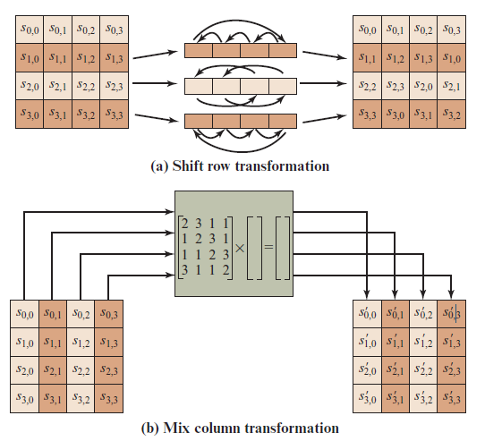
A E S Row and Column Operations
Notes:
The forward shift row transformation ,
called ShiftRows, is depicted in Figure 6.7a. The first row of State is not altered. For
the second row, a 1-byte circular left shift is performed. For the third row, a 2-byte
circular left shift is performed. For the fourth row, a 3-byte circular left shift is performed.
The following is an example of ShiftRows.
The inverse shift row transformation , called InvShiftRows, performs the circular
shifts in the opposite direction for each of the last three rows, with a 1-byte
circular right shift for the second row, and so on.
The forward mix column transformation,
called MixColumns, operates on each column individually. Each byte of a column
is mapped into a new value that is a function of all four bytes in that column. The
transformation can be defined by the following matrix multiplication on State
(Figure 6.7b)
Each element in the product matrix is the sum of products of elements of one row
and one column. In this case, the individual additions and multiplications are
performed in GF(2⁸ ).

Slide 39
Shift-Rows (shr)
shr(A) performs a left-circular-shift i – 1 times on the i-th row in the matrix A
a_{0,0} a_{0,1} a_{0,2} a_{0,3}
shr(A) = a_{1,1} a_{1,2} a_{1,3} a_{1,0 = C}
a_{2,2} a_{2,3} a_{2,0} a_{2,1}
a_{3,3} a_{3,0} a_{3,1} a_{3,2}
shr⁻¹(A) performs a right-circular-shift i – 1 times on the i-th row in the matrix A
a_{0,0} a_{0,1} a_{0,2} a_{0,3}
shr⁻¹(C)= a_{1,0} a_{1,1} a_{1,2} a_{1,3}
a_{2,0} a_{2,1} a_{2,2} a_{2,3}
a_{3,0} a_{3,1} a_{3,2} a_{3,3}
We have shr(shr⁻¹(A)) = shr⁻¹(shr(A)) = A
0
a_{0,0} a_{0,1} a_{0,2} a_{0,3}
a_{1,0} a_{1,1} a_{1,2} a_{1,3}
a_{2,0} a_{2,1} a_{2,2} a_{2,3} a_{3,0} a_{3,1} a_{3,2} a_{3,3}
1
2
3

Slide 40
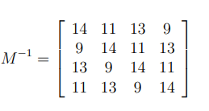
Mix-Columns (mic)
M
A
a_{0,0} a_{0,1} a_{0,2} a_{0,3}
a_{1,0} a_{1,1} a_{1,2} a_{1,3}
a_{2,0} a_{2,1} a_{2,2} a_{2,3} a_{3,0} a_{3,1} a_{3,2} a_{3,3}
Encrypt
2 3 1 1
1 2 3 1
1 1 2 3 3 1 1 2
a_{0,0} a_{0,1} a_{0,2} a_{0,3}
a_{1,0} a_{1,1} a_{1,2} a_{1,3}
a_{2,0} a_{2,1} a_{2,2} a_{2,3} a_{3,0} a_{3,1} a_{3,2} a_{3,3}
A=
=C
$M^{−1}$
C
Decrypt
c_{0,0} c_{0,1} c_{0,2} c_{0,3}
c_{1,0} c_{1,1} c_{1,2} c_{1,3}
c_{2,0} c_{2,1} c_{2,2} c_{2,3} c_{3,0} c_{3,1} c_{3,2} c_{3,3}
A
Addition, subtraction, multiplication, and division on bytes?

Slide 41
Finite Field Arithmetic (3/3)
In the Advanced Encryption Standard (A E S) all operations are performed on 8-bit (1 byte);
The arithmetic operations of addition, multiplication, and division are performed over the finite field G F(2⁸)
addition,
subtraction,
multiplication,
division on polynomials
mod (x⁸ + x⁴ + x³ + x + 1)
Rijndael's finite field
$r= b_{7}b_{6}b_{5}b_{4}b_{3}b_{2}b_{1}b_{0}$ (1 byte)
$$r\left(x\right)={b_{7}x^{7}+b_{6}x^{6}+b_{5}x^{5}+b_{4}x^{4}+b_{3}x^{3}{+b}_{2}x^{2}{+b_{1}x}^{1}+b}_{0}$$
GF(2)[x]/(x⁸ + x⁴ + x³ + x + 1)
https://en.wikipedia.org/wiki/Finite_field_arithmetic

Slide 42
Mix-Columns (mic)
mic(A) = [a’_{ij}]_{4×4} is determined by the following operation (j = 0, 1, 2, 3):
a’_{0,j} = M (a_{0,j}) ⊕ [M (a_{1,j}) ⊕ a_{1,j}] ⊕ a_{2,j} ⊕ a_{3,j}
a’_{1,j} = a_{0,j} ⊕ M (a_{1,j}) ⊕ [M (a_{2,j} )⊕a_{2,j}] ⊕ a_{3,j}
a’_{2,j} = a_{0,j} ⊕ a_{1,j} ⊕ M (a_{2,j} ) ⊕ [M (a_{3,j} ) ⊕ a_{3,j}]
a’_{3,j} = [M (a_{0,j} )⊕ a_{0,j} ] ⊕ a_{1,j} ⊕ a_{2,j} ⊕ M (a_{3,j} )

Slide 43
Mix-Columns (mic)
mic⁻¹(A) is defined as follows:
Let w be a byte and i a positive integer:
M ^{i}(w) = M (M ^{i-1}(w)) (i > 1), M ¹(w) = M (w)
Let
M₁(w) = M³(w) ⊕ M²(w) ⊕ M(w)
M₂(w) = M³(w) ⊕ M(w) ⊕ w
M₃(w) = M³(w) ⊕ M²(w) ⊕ w
M₄(w) = M³(w) ⊕ w
mic⁻¹(A) = [a’’_{ij}]_{4×4} :
a’’_{0,j} = M₁(a_{0,j}) ⊕ M₂(a_{1,j}) ⊕ M₃(a_{2,j}) ⊕ M₄(a_{3,j})
a’’_{1,j} = M₄(a_{0,j}) ⊕ M₁(a_{1,j}) ⊕ M₂(a_{2,j}) ⊕ M₃(a_{3,j})
a’’_{2,j} = M₃(a_{0,j}) ⊕ M₄(a_{1,j}) ⊕ M₁(a_{2,j}) ⊕ M₂(a_{3,j})
a’’_{3,j} = M₂(a_{0,j}) ⊕ M₃(a_{1,j}) ⊕ M₄(a_{2,j}) ⊕ M₁(a_{3,j})
We have mic(mic⁻¹(A)) = mic⁻¹(mic(A)) = A

Slide 44
Add Round Keys (ark)
Rewrite K_{i} as a 4 x 4 matrix of bytes:
k_{0,0} k_{0,1} k_{0,2} k_{0,3}
K_{i} = k_{1,0} k_{1,1} k_{1,2} k_{1,3}
k_{2,0} k_{2,1} k_{2,2} k_{2,3}
k_{3,0} k_{3,1} k_{3,2} k_{3,3}
where each element is a byte and W[4i + j] = k_{0,j}k_{1,j}k_{2,j}k_{3,j}, j = 0, 1 , 2, 3
Initially, let A = M
k_{0,0}⊕ a_{0,0} k_{0,1}⊕ a_{0,1} k_{0,3} ⊕ a_{0,3} k_{0,4} ⊕ a_{0,4}
ark(A, K_{i}) = A ⊕ K_{i} = k_{1,0}⊕ a_{1,0} k_{1,1}⊕ a_{1,1} k_{1,2} ⊕ a_{1,2} k_{1,3} ⊕ a_{1,3} k_{2,0}⊕ a_{2,0} k_{2,1}⊕ a_{2,1} k_{2,2} ⊕ a_{2,2} k_{2,3} ⊕ a_{2,3} k_{3,0}⊕ a_{3,0} k_{3,1}⊕ a_{3,1} k_{3,2} ⊕ a_{3,2} k_{3,3} ⊕ a_{3,3}
Since this is a ⊕ operation, ark^{–1} is the same as ark. We have
ark(ark^{–1}(a, K_{i}), K_{i}) = ark^{–1}(ark(a, K_{i}), K_{i}) = a
_{a0,0} a_{0,1} a_{0,2} a_{0,3}
a_{1,0} a_{1,1} a_{1,2} a_{1,3}
a_{2,0} a_{2,1} a_{2,2} a_{2,3} a_{3,0} a_{3,1} a_{3,2} a_{3,3}
A=

Slide 45
AES-128 Round Keys
Let K = K[0,31]K[32,63]K[64,95]K[96,127] be a 4-word encryption key
AES expands K into a 44-word array W[0,43]
Define a byte transformation function M as follows:
b₆b₅b₄b₃b₂b₁b₀0, if b₇ = 0,
M (b₇b₆b₅b₄b₃b₂b₁b₀) =
b₆b₅b₄b₃b₂b₁b₀0 ⊕ 00011011, if b₇ = 1
Next, let j be a non-negative number. Define m(j) as follows:
00000001, if j = 0
m(j) = 00000010, if j = 1
M (m(j–1)), if j > 1
Finally, define a word-substitution function T as follows, which transforms a 32-bit string into a 32-bit string, using parameter j and the AES S-Box: T(w, j) = [(S(w₂) ⊕ m(j – 1)]S(w₃) S(w₄) S(w₁), where w = w₁w₂w₃w₄ with each w_{i} being a byte

Slide 46
Putting Things Together
Use all of these functions to create round keys of size 4 words (11 round keys are needed for AES-128; i.e. 44 words)
W[0] = K[0, 31]
W[1] = K[32, 63]
W[2] = K[64, 95]
W[3] = K[96, 127]
W[i–4] ⊕ T(W[i–1], i/4), if i is divisible by 4
W[i] =
W[i–4] ⊕ W[i–1], otherwise
i = 4, …, 43
11 round keys: For i = 0, …, 10:
K_{i} = W[4i, 4i + 3] = W[4i + 0] W[4i + 1] W[4i + 2] W[4i + 3]

Slide 47
AES-128 Encryption/Decryption
AES-128 encryption:
Let A_{i} (i = 0, …, 11) be a sequence of state matrices, where A₀ is the initial state matrix M, and A_{i} (i = 1, …, 10) represents the input state matrix at round i
A₁₁ is the cipher text block C, obtained as follows:
A₁ = ark(A₀, K₀)
A_{i+1} = ark(mic(shr(sub(A_{i}))), K_{i}), i = 1,…,9
A₁₁ = arc(shr(sub(A₁₀)), K₁₀))
AES-128 decryption:
Let C₀ = C = A₁₁, where C_{i} is the output state matrix from the previous round
C₁ = ark(C₀, K₁₀)
C_{i+1} = mic⁻¹(ark(sub ⁻¹(shr ⁻¹(C_{i})), K_{10-i})), i = 1,…,9
C₁₁ = ark(sub ⁻¹(shr ⁻¹(C₁₀)), K₀)

Slide 48
Correctness Proof of Decryption
We now show that C₁₁ = A₀
We first show the following equality using mathematical induction:
C_{i} = shr(sub(A_{11-i})), i = 1, …, 10
For i = 1 we have
C₁ = ark(A₁₁, K₁₀)
= A₁₁ ⊕ K₁₀
= ark(shr(sub(A₁₀)), K₁₀) ⊕ K₁₀
= (shr(sub(A₁₀)) ⊕ K₁₀) ⊕ K₁₀
= shr(sub(A₁₀))
Assume that the equality holds for 1 ≤ i ≤ 10. We have
C_{i+1} = mic⁻¹(ark(sub ⁻¹(shr ⁻¹(C_{i})), K_{10-i}))
= mic⁻¹(ark(sub ⁻¹(shr ⁻¹(shr(sub(A_{11-i})))) ⊕ K_{10-i}))
= mic⁻¹(A_{11-i}⊕ K_{10-i})
= mic⁻¹(ark(mic(shr(sub(A_{10-i}))), K_{10-i}) ⊕ K_{10-i})
= mic⁻¹([mic(shr(sub(A_{10-i}))) ⊕ K_{10-i}] ⊕ K_{10-i})
= shr(sub(A_{10-i})
= shr(sub(A_{11-(i+1)}))
This completes the induction proof

Slide 49
Correctness Proof of Decryption
Finally, we have
C₁₁ = ark(sub⁻¹(shr⁻¹(C₁₀)), K₀)
= sub⁻¹(shr⁻¹(shr(sub(A₁)))) ⊕ K₀
= A₁ ⊕ K₀
= (A₀ ⊕ K₀) ⊕ K₀
= A₀
This completes the correctness proof of AES-128 Decryption

Slide 50
A E S Key Expansion
Takes as input a four-word (16 byte) key and produces a linear array of 44 words (176) bytes
This is sufficient to provide a four-word round key for the initial AddRoundKey stage and each of the 10 rounds of the cipher
Key is copied into the first four words of the expanded key
The remainder of the expanded key is filled in four words at a time
Each added word w[i] depends on the immediately preceding word, w[i – 1], and the word four positions back, w[i – 4]
In three out of four cases a simple X O R is used
For a word whose position in the w array is a multiple of 4, a more complex function is used

Slide 51
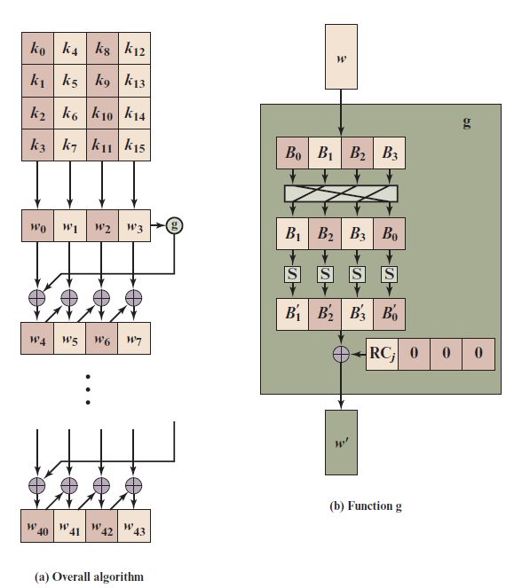
A E S Key Expansion

Slide 52
Key Expansion Rationale (1 of 2)
The Rijndael developers designed the expansion key algorithm to be resistant to known cryptanalytic attacks
Inclusion of a round-dependent round constant eliminates the symmetry between the ways in which round keys are generated in different rounds

Slide 53
Key Expansion Rationale (2 of 2)
The specific criteria that were used are:
Knowledge of a part of the cipher key or round key does not enable calculation of many other round-key bits
An invertible transformation
Speed on a wide range of processors
Usage of round constants to eliminate symmetries
Diffusion of cipher key differences into the round keys
Enough nonlinearity to prohibit the full determination of round key differences from cipher key differences only
Simplicity of description

Slide 54
A E S Implementation
A E S decryption cipher is not identical to the encryption cipher
The sequence of transformations differs although the form of the key schedules is the same
Has the disadvantage that two separate software or firmware modules are needed for applications that require both encryption and decryption
Two separate changes are needed to bring the decryption structure in line with the encryption structure
The first two stages of the decryption round need to be interchanged
The second two stages of the decryption round need to be interchanged

Slide 55
Modes of Operations
NIST has approved 14 modes
8 confidentiality modes: ECB, CBC, OFB, CFB, CTR, XTS-AES, FF1, FF3;
1 authentication mode: CMAC;
5 combined modes for confidentiality and authentication: CCM, GCM, KW, KWP,TKW
https://csrc.nist.gov/projects/block-cipher-techniques/bcm/current-modes

Slide 56
Topics
EBC, CBC, CFB, OFB, CTR
Notes and Remarks on each modes

Slide 57
Modes of Operation
Block ciphers encrypt fixed size blocks
eg. DES encrypts 64-bit blocks, with 56-bit key
AES encrypts 128-bit blocks with 128, 192, 256-bit key
Need way to use in practise, given usually have arbitrary amount of data to encrypt
Partition message into separate block for ciphering
A mode of operation describes the process of encrypting each of these blocks under a single key
Some modes may use randomized addition input value

Slide 58
Quick History
1981
Early modes of operation: ECB, CBC, CFB, OFB
DES Modes of operation
http://www.itl.nist.gov/fipspubs/fip81.htm
Revised and including CTR mode and AES
Recommendation for Block Cipher Modes of Operation
http://csrc.nist.gov/publications/nistpubs/800-38a/sp800-38a.pdf
New Mode : XTS-AES
Recommendation for Block Cipher Modes of Operation: The XTS-AES Mode for Confidentiality on Storage Devices
http://csrc.nist.gov/publications/nistpubs/800-38E/nist-sp-800-38E.pdf
2001
2010

Slide 59
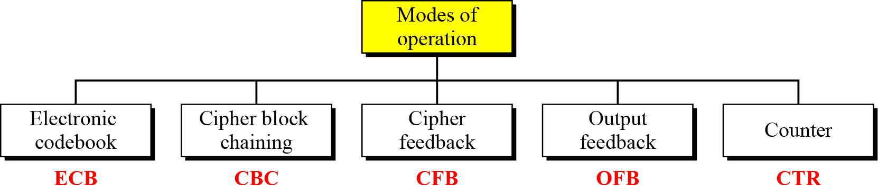
Modes of Operation Taxonomy
Current well-known modes of operation

Slide 60
Moe Technical Notes
Initialize Vector (IV)
a block of bits to randomize the encryption and hence to produce distinct ciphertext
Nonce : Number (used) Once
Random of psuedorandom number to ensure that past communications can not be reused in replay attacks
Some also refer to initialize vector as nonce
Padding
final block may require a padding to fit a block size
Method
Add null Bytes
Add 0x80 and many 0x00
Add the n bytes with value n

Slide 61
Electronic Codebook Book (ECB)
Message is broken into independent blocks which are encrypted
Each block is a value which is substituted, like a codebook, hence name
Each block is encoded independently of the other blocks
$Ci = E_{K}(Pi)$
Uses: secure transmission of single values

Slide 62
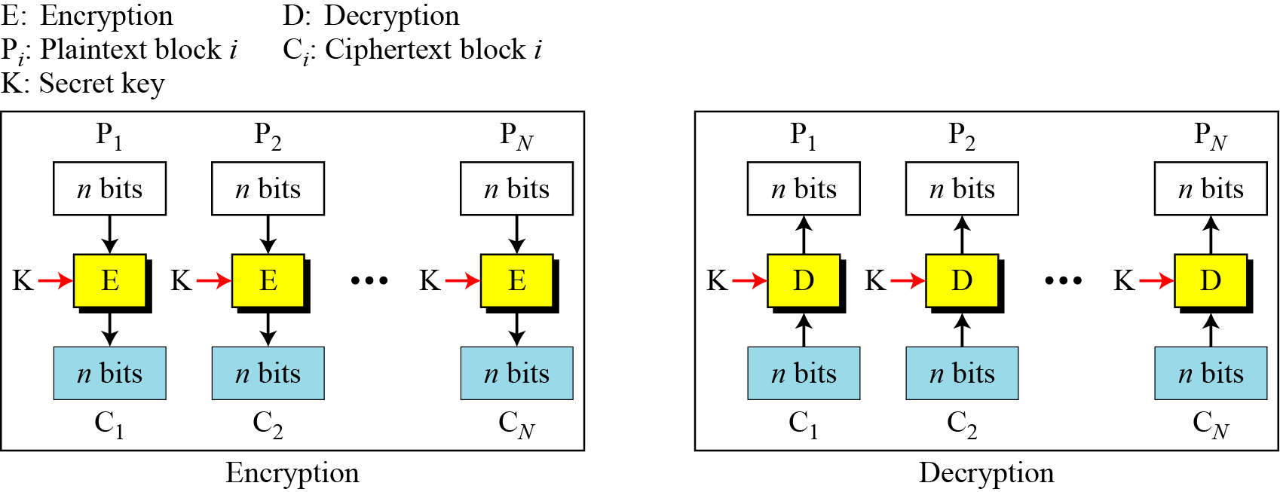
ECB Scheme
$P=P_{1}\left|\left|P_{2}\right|\right|…|P_{n}^{∗}$
$$n=64 or 128$$
$C=C_{1}\left|\left|C_{2}\right|\right|…|C_{n}$
Notes:
Stallings Fig 3-11.

Slide 63
Remarks on ECB
Strength: it’s simple.
Weakness:
Repetitive data contained in the plaintext may show in the ciphertext, if aligned with blocks.
If the same message is encrypted (with the same key) and sent twice, their ciphertext are the same.
Typical application:
secure transmission of short pieces of information (e.g. a temporary encryption key)

Slide 64
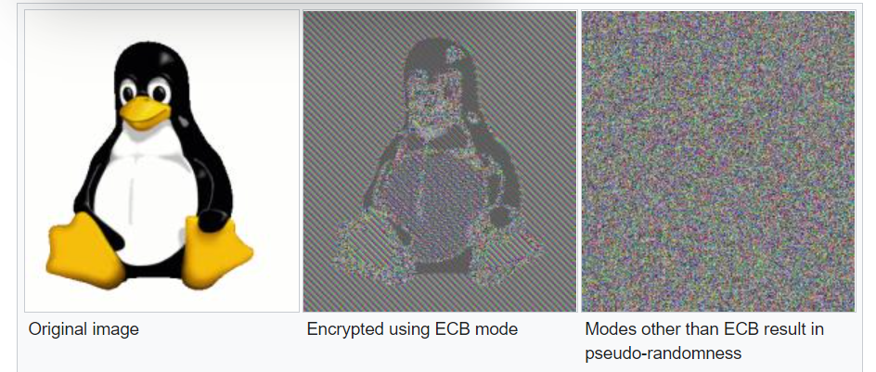
Remarks on ECB

Slide 65
Cipher Block Chaining (CBC)
Solve security deficiencies in ECB
Repeated same plaintext block result different ciphertext block
Each previous cipher blocks is chained to be input with current plaintext block, hence name
Use Initial Vector (IV) to start process
C_{i} = E_{K} (P_{i}$⊕$C_{i-1})
C₀ = IV
Uses: bulk data encryption, authentication

Slide 66
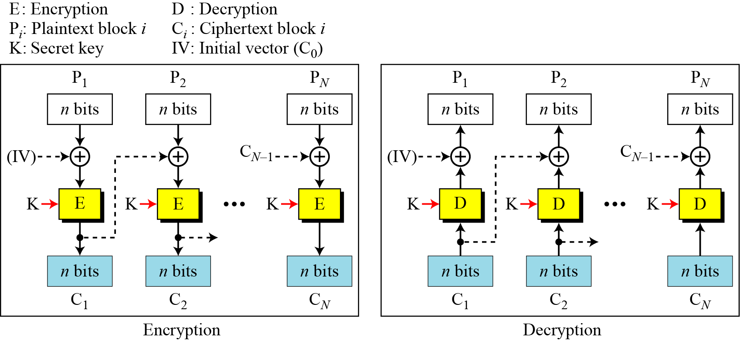
CBC scheme
Notes:
Stallings Fig 3-12.

Slide 67
Remarks on CBC
The encryption of a block depends on the current and all blocks before it.
So, repeated plaintext blocks are encrypted differently.
Initialization Vector (IV)
May sent encrypted in ECB mode before the rest of ciphertext
Does not guarantee data integrity!

Slide 68
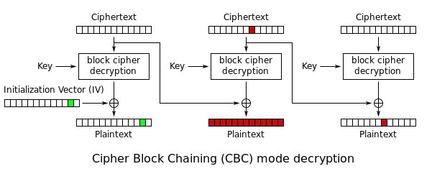
Remarks on CBC
Does not guarantee data integrity!
https://alicegg.tech/2019/06/23/aes-cbc.html
https://cve.mitre.org/cgi-bin/cvename.cgi?name=2020-8911

Slide 69
Cipher FeedBack (CFB)
Use Initial Vector to start process
Encrypt previous ciphertext , then combined with the plaintext block using X-OR to produce the current ciphertext
Cipher is fed back (hence name) to concatenate with the rest of IV
Plaintext is treated as a stream of bits
Any number of bit (1, 8 or 64 or whatever) to be feed back (denoted CFB-1, CFB-8, CFB-64)
Relation between plaintext and ciphertext
C_{i} = P_{i} $⊕$ SelectLeft(E_{K} (ShiftLeft(C_{i-1})))
C₀ = IV
Uses: stream data encryption, authentication

Slide 70
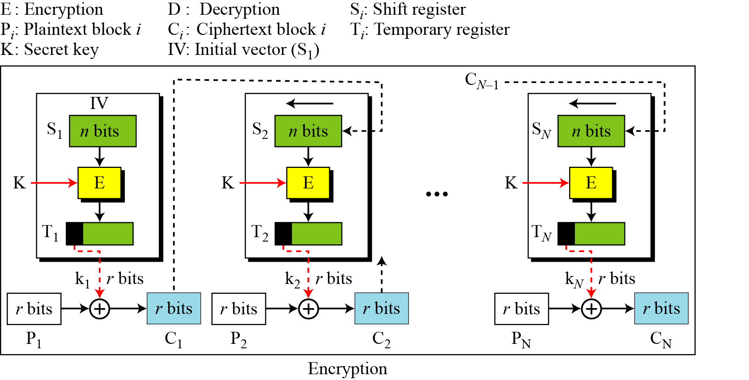
CFB Scheme

Slide 71
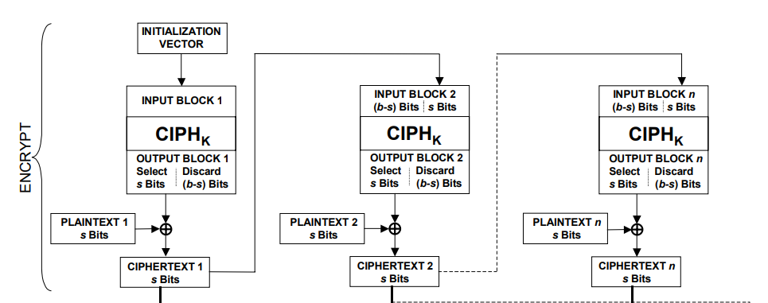
CFB Encryption/Decryption
Notes:
Stallings Fig 3-13.

Slide 72
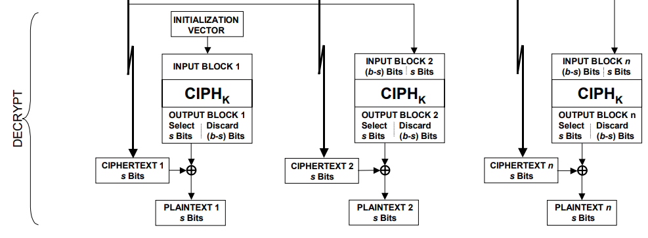
CFB Encryption/Decryption
Notes:
Stallings Fig 3-13.

Slide 73
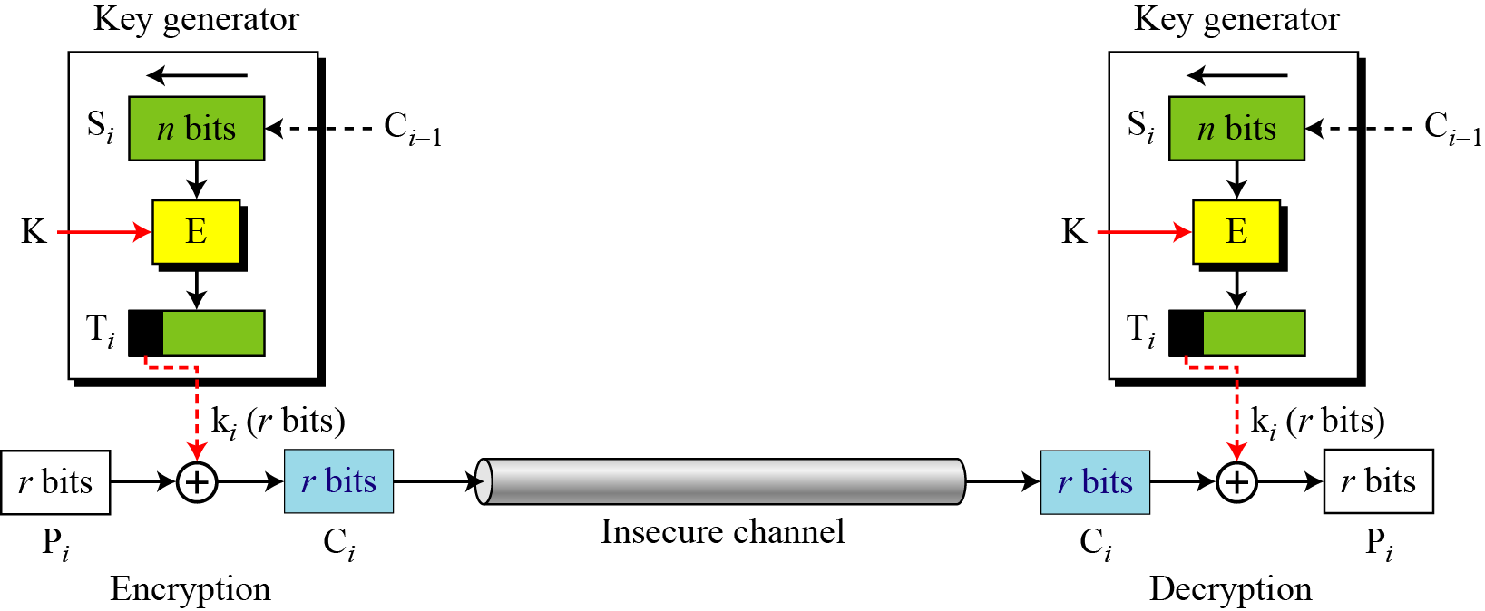
CFB as a Stream Cipher
In CFB mode, encipherment and decipherment use the encryption function of the underlying block cipher.

Slide 74
Remark on CFB
The block cipher is used as a stream cipher.
enable to encrypt any number of bits e.g. single bits or single characters (bytes)
S=1 : bit stream cipher
S=8 : character stream cipher
S=64, S=128 (block cipher)
A ciphertext segment depends on the current and all preceding plaintext segments.
A corrupted ciphertext segment during transmission will affect the current and next several plaintext segments.

Slide 75
Output FeedBack (OFB)
Very similar to CFB
But output of the encryption function output of cipher is fed back (hence name), instead of ciphertext
Feedback is independent of message
Relation between plaintext and ciphertext
C_{i} = P_{i} ⊕ O_{i}
O_{i} = E_{K} (O_{i-1})
O₀ = IV
Uses: stream encryption over noisy channels
Notes:
The alternative to CFB is OFB. Here the generation of the "random" bits is independent of the message being encrypted. The advantage is that firstly, they can be computed in advance, good for bursty traffic, and secondly, any bit error only affects a single bit. Thus this is good for noisy links (eg satellite TV transmissions etc).

Slide 76
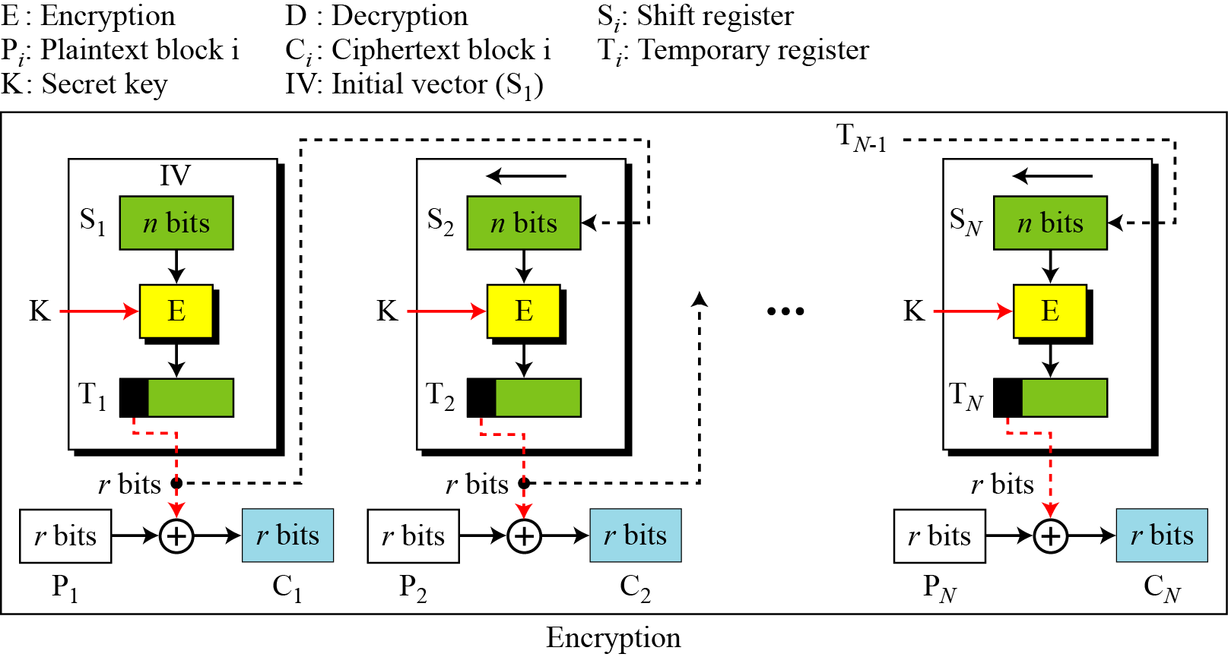
OFB Scheme

Slide 77
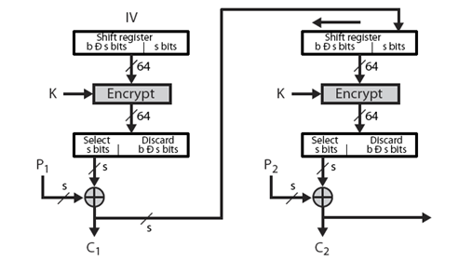
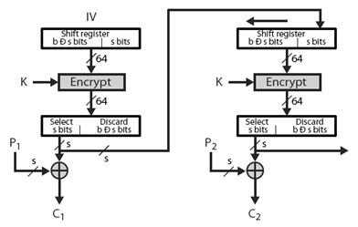
CFB V.S. OFB
Cipher Feedback
Output Feedback

Slide 78
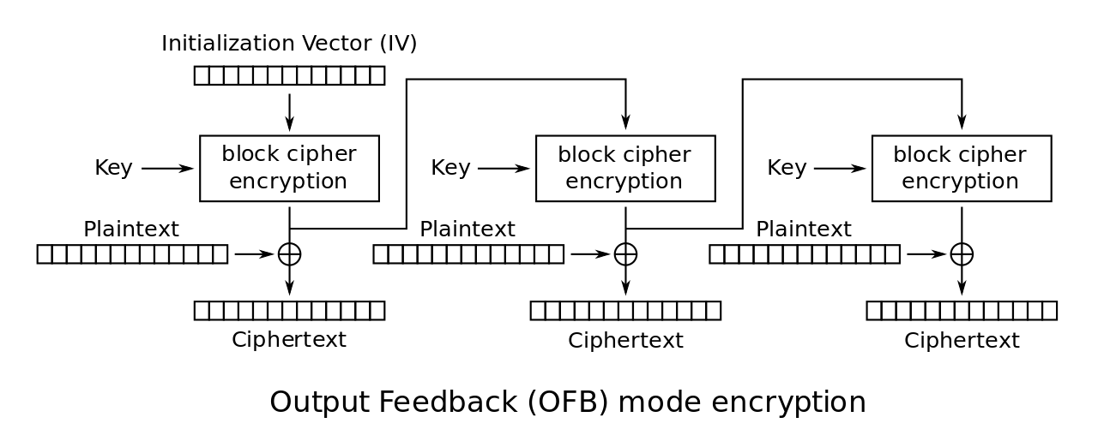
OFB Encryption and Decryption
Notes:
Stallings Fig 3-14.

Slide 79
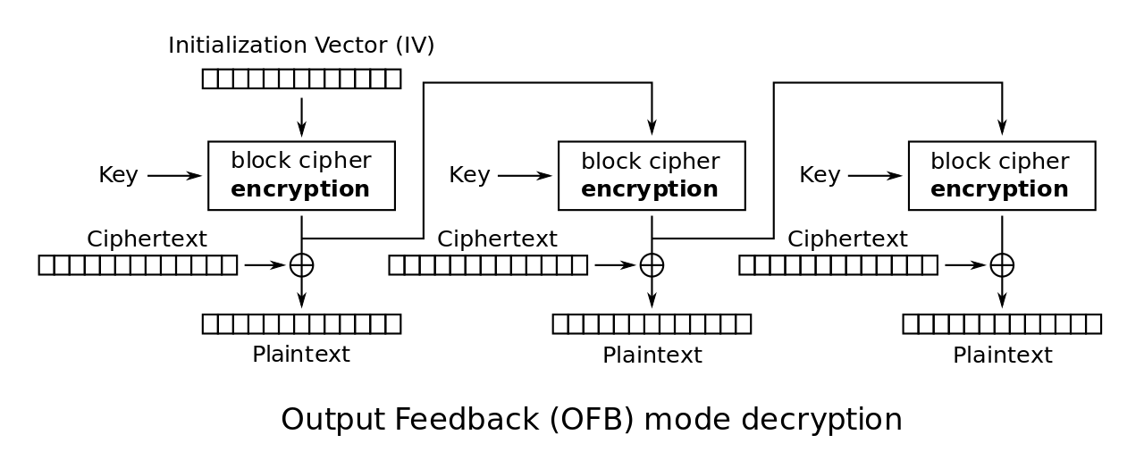
OFB Encryption and Decryption
Notes:
Stallings Fig 3-14.

Slide 80
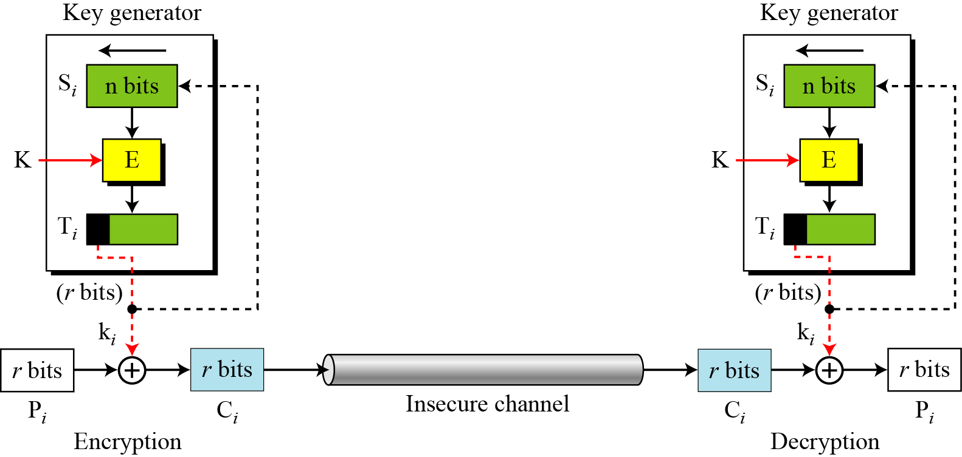
OFB as a Stream Cipher
In OFB mode, encipherment and decipherment use the encryption function of the underlying block cipher.

Slide 81
Remarks on OFB
Each bit in the ciphertext is independent of the previous bit or bits. This avoids error propagation
Pre-compute of forward cipher is possible
Security issue
when j^{th} plaintext is known, the j^{th} output of the forward cipher function will be known
Easily cover j^{th} plaintext block of other message with the same IV
Require that the IV is a nonce

Slide 82
Counter (CTR)
Encrypts counter value with the key rather than any feedback value (no feedback)
Counter for each plaintext will be different
can be any function which produces a sequence which is guaranteed not to repeat for a long time
Relation
C_{i} = P_{i} ⊕ O_{i}
O_{i} = E_{K} (i)
Uses: high-speed network encryptions

Slide 83
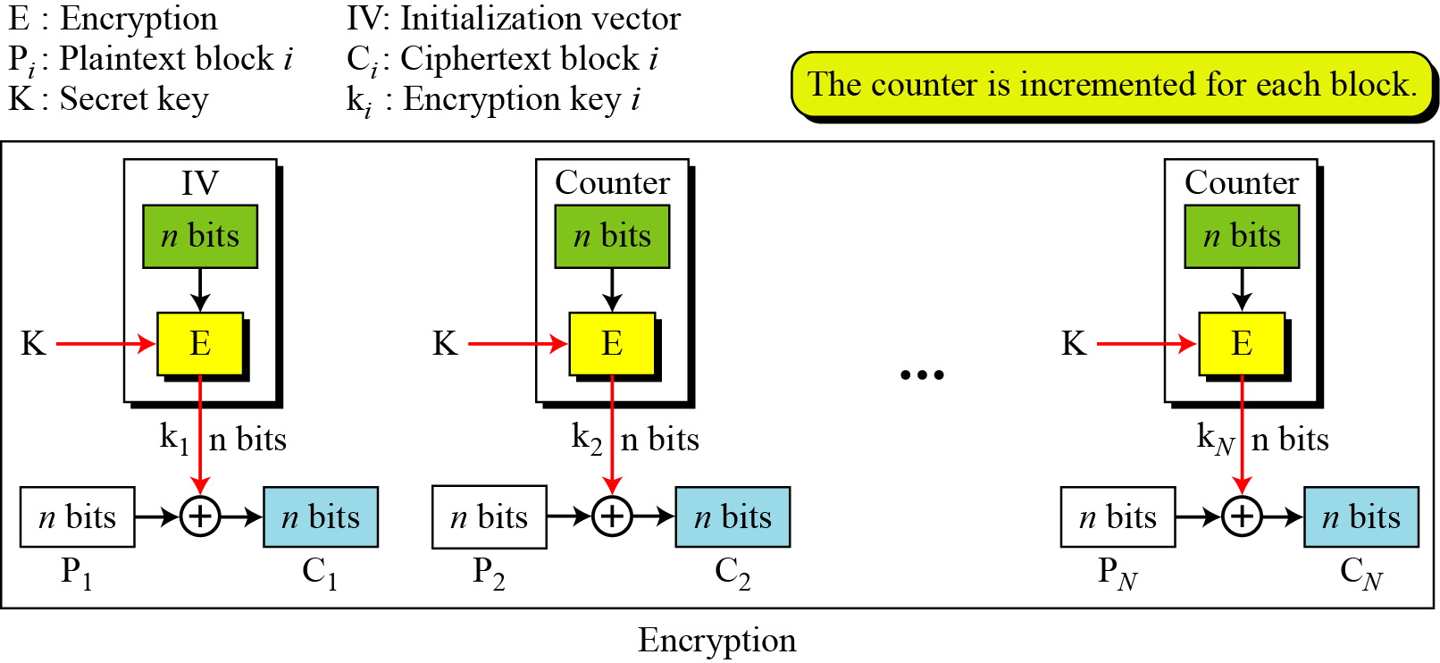
CTR Scheme

Slide 84
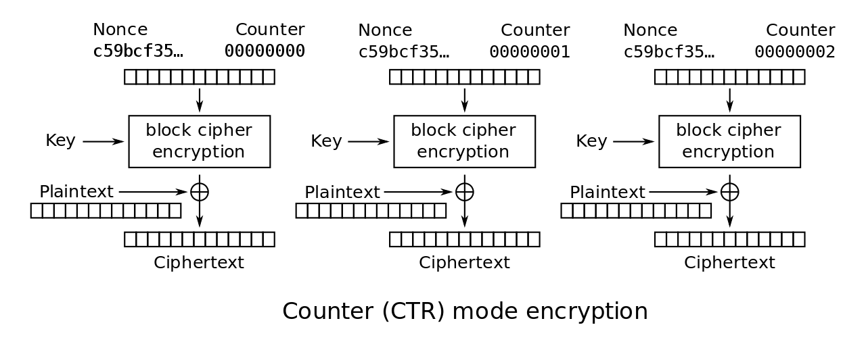
CTR Encryption and Decryption
Notes:
Stallings Fig 3-15.

Slide 85
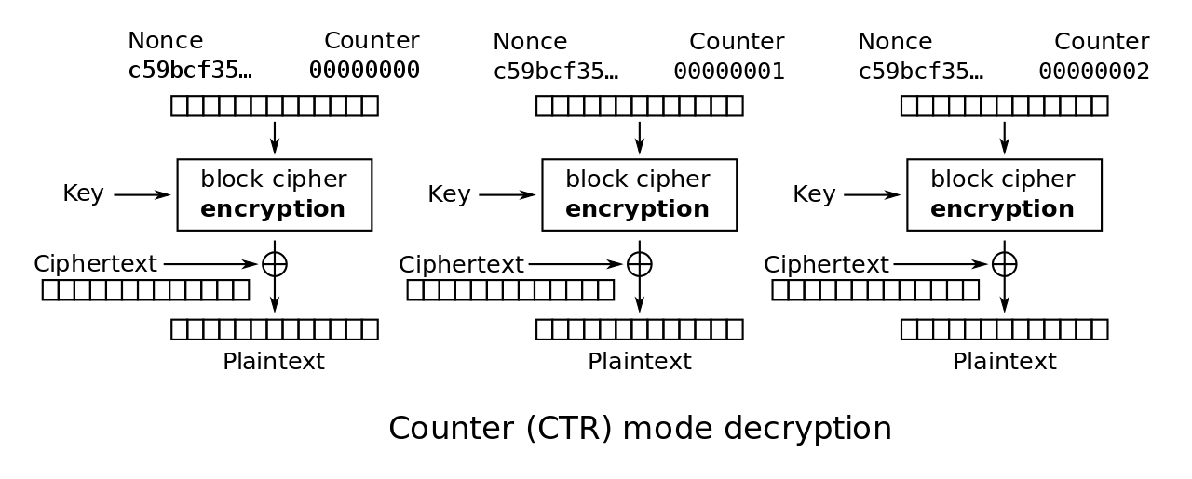
CTR Encryption and Decryption
Notes:
Stallings Fig 3-15.

Slide 86
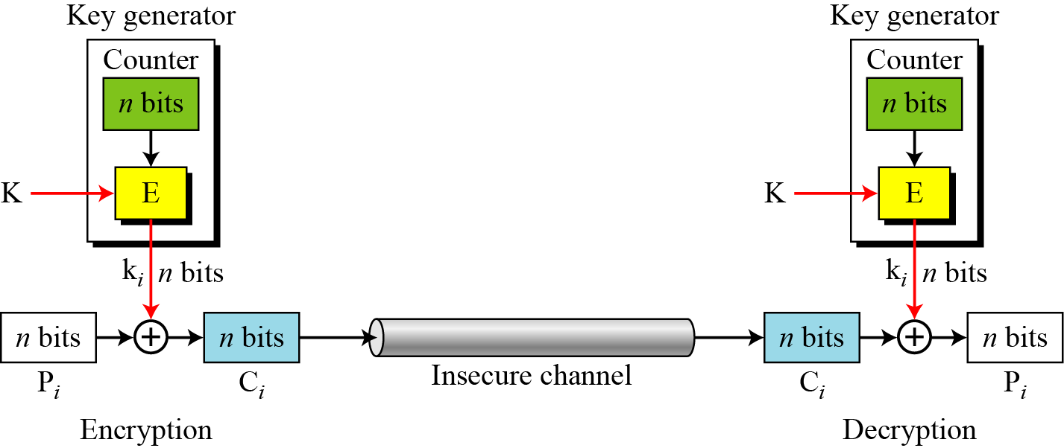
OFB as a Stream Cipher

Slide 87
Remark on CTR
Strengthes:
Needs only the encryption algorithm
Random access to encrypted data blocks
blocks can be processed (encrypted or decrypted) in parallel
Simple; fast encryption/decryption
Counter must be
Must be unknown and unpredictable
pseudo-randomness in the key stream is a goal

Slide 88
Remark on each mode
Basically two types:
block cipher
stream cipher
CBC is an excellent block cipher
CFB, OFB, and CTR are stream ciphers
CTR is faster because simpler and it allows parallel processing

Slide 89
Modes and IV
An IV has different security requirements than a key
Generally, an IV will not be reused under the same key
CBC and CFB
reusing an IV leaks some information about the first block of plaintext, and about any common prefix shared by the two messages
OFB and CTR
reusing an IV completely destroys security

Slide 90
CBC and CTR comparison
CBC | CTR
Padding needed | No padding
No parallel processing | Parallel processing
Separate encryption and decryption functions | Encryption function alone is enough
Random IV or a nonce | Unique nonce
Nonce reuse leaks some information about initial plaintext block | Nonce reuse will leak information about the entire message

Slide 91
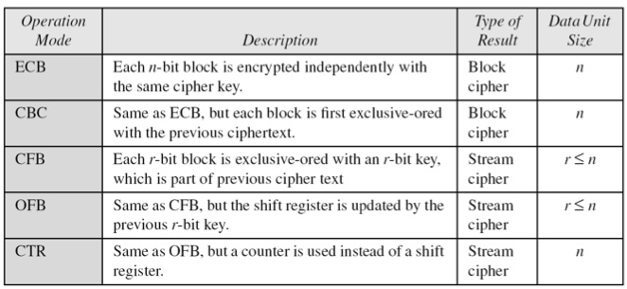
Comparison of Different Modes

Slide 92
Comparison of Modes
Mode | Description | Application
ECB | 64-bit plaintext block encoded separately | Secure transmission of encryption key
CBC | 64-bit plaintext blocks are XORed with preceding 64-bit ciphertext | Commonly used method. Used for authentication
CFB | s bits are processed at a time and used similar to CBC | Primary stream cipher. Used for authentication

Slide 93
Comparison of Modes
Mode | Description | Application
OFB | Similar to CFB except that the output is fed back | Stream cipher well suited for transmission over noisy channels
CTR | Key calculated using the nonce and the counter value. Counter is incremented for each block | General purpose block oriented transmission. Used for high-speed communications

Slide 94
Final Notes
ECB, CBC, OFB, CFB, CTR, and XTS modes only provide confidentiality
To ensure an encrypted message is not accidentally modified or maliciously tampered requires a separate Message Authentication Code (MAC)
Several MAC schemes
HMAC, CMAC and GMAC
But.. compositing a confidentiality mode with an authenticity mode could be difficult and error prone
New modes combined confidentiality and data integrity into a single cryptographic primitive
CCM, GCM, CWC, EAX, IAPM and OCB

